Slide 1
Concrete Inspection
Imaging Solution
Bouazzaoui Mohammed
Junior Data Scientist @Becode

Slide 2
Problem
Manual inspection for cracks in pictures of concrete surfaces takes to much time

Slide 3
Solution
Using imageprocessing and AI automate the detection of cracks
- Preprocess the image
- Let model detect the crack

Slide 4
Image dataset
SDNET2018
8500 crack images
48000 non crack images

Slide 5
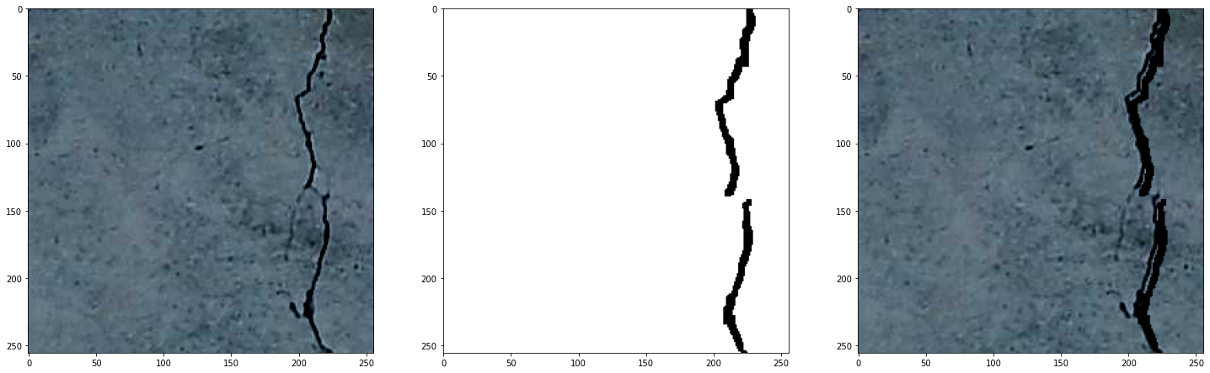
Preprocessing the images
Original Filtered Original + Filtered

Slide 6
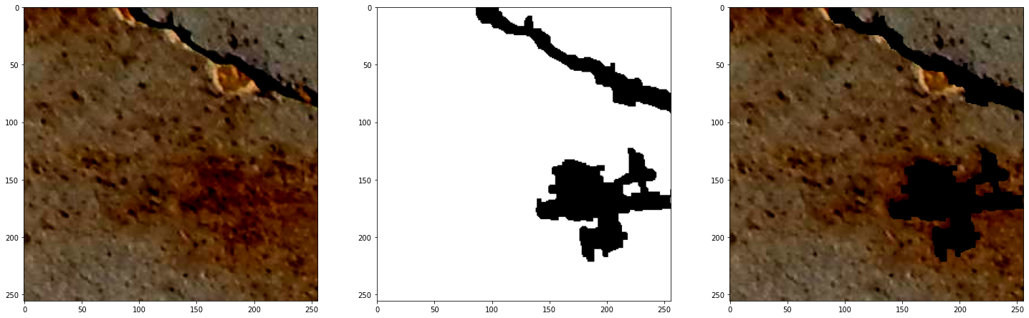
Preprocessing the images
Original Filtered Original + Filtered

Slide 7
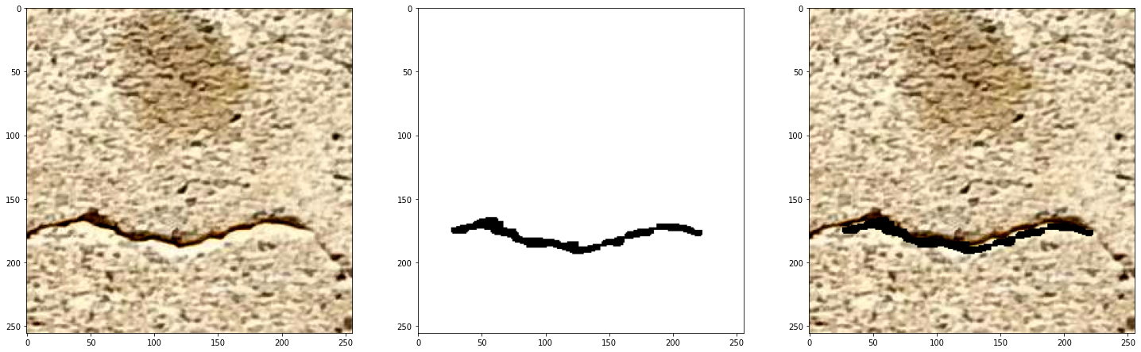
Preprocessing the images
Original Filtered Original + Filtered

Slide 8
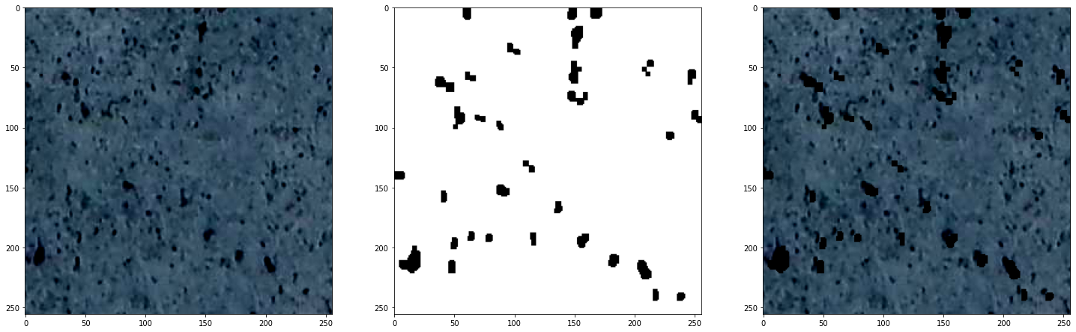
Preprocessing the images
Original Filtered Original + Filtered

Slide 9
Modelling
MobileNetV2 Imageclassification
+
Flatten()
Dense(64, activation='relu')
Dropout(0.5)
Dense(2, activation='sigmoid')

Slide 10
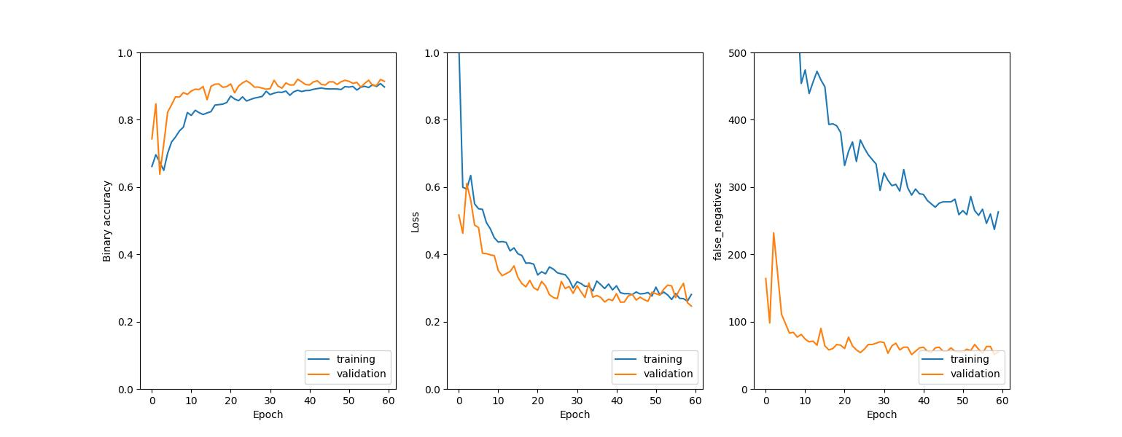
Training the model

Slide 11
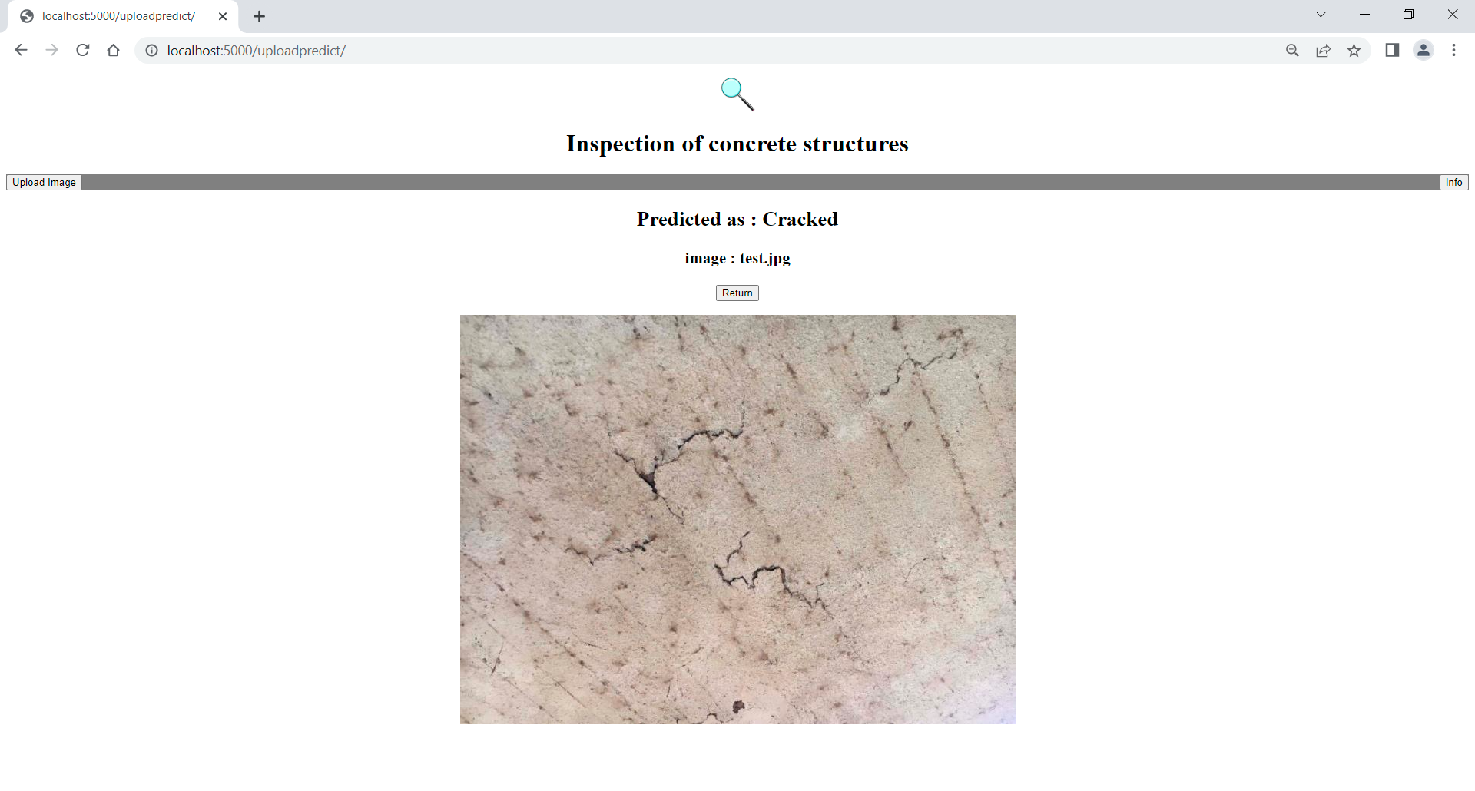
Demo MVP

Slide 12
Thank you for your attention. Questions?
https://www.linkedin.com/in/mbouazzaoui/

